Slide 1

RESEARCH MASTERCLASS FOR CLINICIANS · MODULE 2
Data Types, Summary & Presentation
From Raw Numbers to a Publication-Ready Table 1
Built around peer-reviewed evidence from Zimbabwe, Zambia and Southern Africa — HIV, metabolic syndrome and adolescent hypertension datasets.
www.newlandsclinic.org.zw

Slide 2
MODULE 2 · TOPIC 2 · STATISTICS FOR EPIDEMIOLOGY
Data Types, Summary & Presentation
BY THE END OF THIS SESSION, YOU WILL BE ABLE TO:
1
Classify a variable as nominal, ordinal, discrete or continuous.
2
Choose the correct central tendency measure (mean, median, mode) for a given variable.
3
Choose the correct dispersion measure (range, IQR, variance, SD) and interpret it.
4
Recognise skewed vs symmetric distributions and know when mean/SD misleads.
5
Construct a baseline “Table 1” and select the correct chart type for a variable.
Research Masterclass for Clinicians · Newlands Clinic
www.newlandsclinic.org.zw
Notes:
Before you can choose a statistical test, you must classify your variables correctly. Data type dictates which summary statistic is valid and which chart tells the truth.

Slide 3
SECTION 1 · FOUNDATIONS
Why the Data Type Comes First
Every summary statistic and every chart assumes a specific data type. Get the type wrong, and the “summary” becomes meaningless — or actively misleading.
THE GOLDEN RULE
Ask three questions before summarising any variable:
901
Participants screened in Chihota et al. (2022, J Int AIDS Soc) across Zambia & Zimbabwe — a mix of categorical (sex, HIV status), discrete (age in years) and continuous (CD4 count, viral load) variables in one dataset.
Categories or numbers?
Sex, HIV status, ART regimen → categories. Age, CD4, BP → numbers.
If numbers — counted or measured?
Number of clinic visits (counted, discrete) vs weight in kg (measured, continuous).
16,883
Youth aged 18–24 analysed in Sabapathy et al. (2024, Lancet Child Adolesc Health) — systolic/diastolic BP (continuous), hypertension status (binary categorical), and age (discrete, median 20, IQR 19–22).
If numbers — symmetric or skewed?
This decides mean vs median, SD vs IQR, and which chart to draw.
Research Masterclass for Clinicians · Newlands Clinic
www.newlandsclinic.org.zw

Slide 4
SECTION 1 · THE DATA TYPE HIERARCHY
Categorical vs Numerical: The Four Basic Types
NOMINAL · categorical
ORDINAL · categorical
Named categories, no natural order
Ranked categories, unequal spacing
Categories could be re-ordered without losing any meaning.
A meaningful order exists, but the “distance” between categories is unequal or unknown.
e.g. sex, HIV status, ART regimen (TDF/3TC/DTG vs TDF/3TC/EFV), district of residence
e.g. WHO clinical stage (I–IV), tumour grade, Likert-scale satisfaction (poor/fair/good/excellent)
DISCRETE · numerical
CONTINUOUS · numerical
Counted whole numbers
Measured on a scale
Values jump between integers — a fraction is not meaningful.
Any value within a range is possible, limited only by instrument precision.
e.g. number of children, number of clinic visits in a year, parity, age in completed years
e.g. CD4 count (cells/mm³), viral load (copies/ml), systolic BP (mmHg), weight (kg)
Binary variables (e.g. hypertension: yes/no) are a special case of nominal data with exactly two categories — common in clinical research and the basis of proportions and odds.
Research Masterclass for Clinicians · Newlands Clinic
www.newlandsclinic.org.zw
Notes:
Broader categories are categorical and numerical. Under numeric you get discrete and continous

Slide 5
SECTION 2 · DESCRIPTIVE STATISTICS
Choosing the Right Summary Statistic
Once a variable's type is known, the choice of central tendency and dispersion follows directly.
Data type | Central tendency | Dispersion | Typical report style
Nominal / ordinal | Mode | — | n (%) per category
Numerical — symmetric | Mean | Standard deviation (SD) | Mean ± SD
Numerical — skewed | Median | Interquartile range (IQR) | Median (IQR)
Is the variable named categories with no order?
→
Mode + n (%)
Is it numeric and roughly bell-shaped?
→
Mean & SD
Is it numeric but skewed, or has outliers?
→
Median & IQR
Chihota et al. (2022) reported CD4 count and viral load as median (IQR) — a signal the authors detected skewness and correctly avoided the mean.
Research Masterclass for Clinicians · Newlands Clinic
www.newlandsclinic.org.zw

Slide 6
SECTION 2 · CENTRAL TENDENCY
Mean, Median & Mode — A Worked Comparison
TOY DATASET: CD4 COUNT (cells/mm³), n=9
REGIONAL EVIDENCE
80, 95, 110, 140, 160, 190, 210, 240, 980
Chihota BV et al. (2022) reported CD4 count in PLWH as:
Measure | Value | Sensitive to the 980 outlier?
Mean | 245.0 | Yes — pulled sharply upward
Median | 160.0 | No — robust to the outlier
Mode | None (all unique) | n/a
Median 228 cells/mm³
IQR 108–412
Viral load was even more skewed: median 24,114 copies/ml, IQR 277–214,271 — a >770-fold range between the 25th and 75th percentile. A mean here would be dominated by a handful of very high values.
A single value of 980 drags the mean up by 85 points while leaving the median almost untouched — exactly why the median is preferred whenever outliers or skewness are present.
Research Masterclass for Clinicians · Newlands Clinic
www.newlandsclinic.org.zw

Slide 7
SECTION 2 — CHECK YOUR UNDERSTANDING
Mean or Median?
A Harare research team measures length of hospital stay (in days) for 40 patients admitted with severe malaria. Most patients stay 3–5 days, but two patients with complications stay 45 and 60 days.
Which pair of statistics should be reported for “length of stay”?
Research Masterclass for Clinicians · Newlands Clinic
www.newlandsclinic.org.zw
Notes:
Two extreme values (45 and 60 days) will drag the mean upward and inflate the SD, giving a misleading picture of the “typical” stay. The median and IQR are robust to these outliers and better reflect that most patients stayed 3–5 days.

Slide 8
SECTION 2 · DISPERSION
Measures of Spread: Range, IQR, Variance & SD
Range
CD4 COUNT — CHIHOTA ET AL., 2022
Maximum − minimum. Simple but entirely driven by the two most extreme values.
Statistic
Value
Median
228 cells/mm³
Interquartile Range (IQR)
Q1 (25th pct.)
108 cells/mm³
The middle 50% of the data: 75th percentile (Q3) − 25th percentile (Q1). Robust to outliers — pairs with the median.
Q3 (75th pct.)
412 cells/mm³
IQR
304 cells/mm³
Standard Deviation (SD)
Reported as “228 (IQR 108–412)” — the standard format in medical journals: median (Q1–Q3).
Average distance of each observation from the mean. Pairs with the mean; assumes rough symmetry.
Research Masterclass for Clinicians · Newlands Clinic
www.newlandsclinic.org.zw
Notes:
Might be called measures of dispersion in some literature
Range, is not usually used but can be useful for setting context SD average distance an observation is from the mean
IQR usually reported as the q1 and q3 values and often not mixed

Slide 9
SECTION 2 · DISTRIBUTION SHAPE
Symmetric vs Skewed Distributions
1
Symmetric distribution
2
Right-skewed distribution
Mean ≈ median ≈ mode. The bell-shaped “normal” curve is the classic example (covered in depth in Topic 3, Module 2).
A long tail of high values pulls the mean above the median. Extremely common in clinical labs: viral load, CD4 count, hospital costs.
Use: Mean ± SD
Use: Median (IQR)
Chart: Histogram looks bell-shaped; box plot is centred
Chart: Histogram has a long right tail; box plot shows whiskers/outliers on the high side
Quick check: if mean > median, the data are right-skewed. If mean < median, left-skewed. If mean ≈ median, roughly symmetric.
Research Masterclass for Clinicians · Newlands Clinic
www.newlandsclinic.org.zw

Slide 10
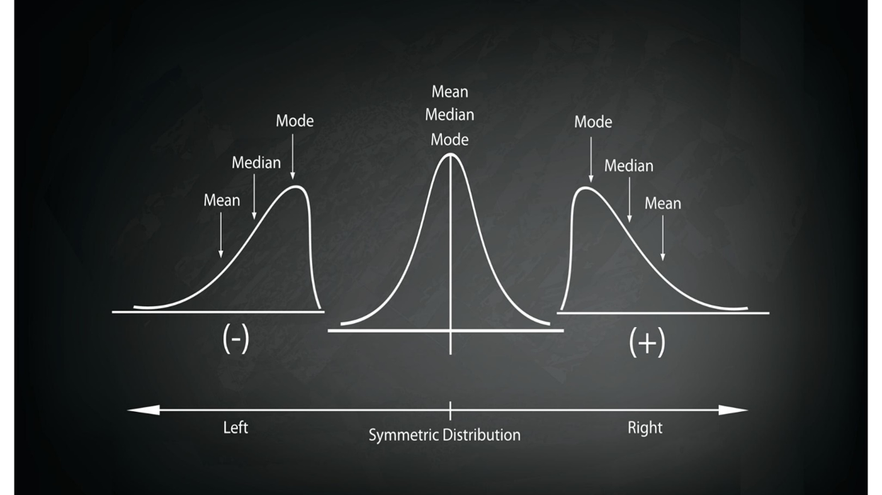
Notes:
A bit of contentext

Slide 11
SECTION 3 · DATA PRESENTATION — TABLES
Constructing a Baseline “Table 1”
Every clinical paper opens with a baseline characteristics table — matching each variable to the correct summary format by data type.
Characteristic | Data type | Summary | Value (illustrative)
Sex | Nominal | n (%) | Female 9,973/16,883 (59.1%)
HIV status | Nominal (binary) | n (%) | PLWH 420/901 (47%)
Age (years) | Discrete, skewed | Median (IQR) | 20 (19–22)
CD4 count (cells/mm³) | Continuous, skewed | Median (IQR) | 228 (108–412)
Metabolic syndrome | Nominal (binary) | n (%) | 172/901 (19%)
A well-constructed Table 1 legitimately mixes formats row by row — some report n (%), others median (IQR), and (with genuinely symmetric numeric variables) some may report mean ± SD. A table that forces every row into an identical format is very likely misrepresenting at least one variable.
Research Masterclass for Clinicians · Newlands Clinic
www.newlandsclinic.org.zw

Slide 12
SECTION 3 — CHECK YOUR UNDERSTANDING
Spot the Table 1 Error
A draft manuscript reports: “ART regimen: mean = 1.8 (SD 0.6)”, where regimen was coded 1 = TDF/3TC/DTG, 2 = TDF/3TC/EFV, 3 = AZT/3TC/LPVr.
What is the problem with this table row?
Research Masterclass for Clinicians · Newlands Clinic
www.newlandsclinic.org.zw
Notes:
ART regimen is nominal — the codes 1, 2 and 3 are arbitrary labels with no numeric meaning or order. Averaging them produces a number (“1.8”) that does not correspond to any real regimen. Report it as n (%) per category instead.

Slide 13
SECTION 3 · DATA PRESENTATION — FIGURES
Choosing the Right Chart by Data Type
Data type | Best chart | Avoid
Nominal / ordinal (1 variable) | Bar chart | Pie chart with >5 slices; 3D effects
Continuous (1 variable, distribution) | Histogram or box plot | Bar chart (implies discrete categories)
Continuous by group (comparison) | Grouped box plot | Bar chart of means alone (hides spread)
Two continuous variables | Scatter plot | Line joining unordered points
Trend over time | Line chart | Bar chart for a continuous time trend
Is the variable made of named categories?
→
Bar chart
Do you want to show the shape of one numeric variable?
→
Histogram / box plot
Comparing a numeric variable across groups?
→
Grouped box plot
Relationship between two numeric variables?
→
Scatter plot
Research Masterclass for Clinicians · Newlands Clinic
www.newlandsclinic.org.zw

Slide 14
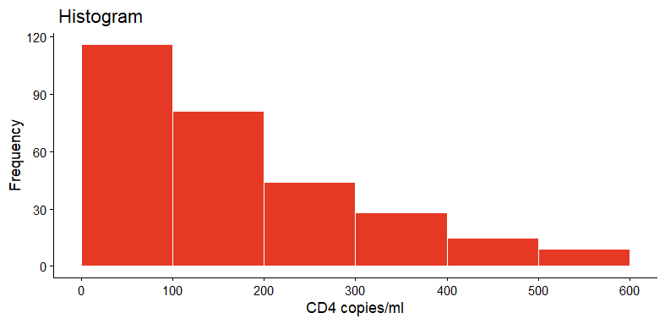
SECTION 3 · DATA PRESENTATION — FIGURES
The Five Charts, Rendered
Illustrative charts built from the decision matrix on the previous slide — same data types, same rules.
BAR CHART — nominal
HISTOGRAM — continuous, skewed
BOX PLOT — continuous by group
Female
Male
ART regimen — n (%) per category
CD4 count — long right tail
Systolic BP by sex — median, IQR & range
SCATTER PLOT — two continuous
LINE CHART — trend over time
Match the chart to the data type on the table — never the other way around.
Age vs systolic BP — each dot = 1 participant
Annual clinic enrolment — ordered time points
Research Masterclass for Clinicians · Newlands Clinic
www.newlandsclinic.org.zw

Slide 15
SECTION 3 · REGIONAL EVIDENCE
Reading a Real Figure: Hypertension by Sex, Zimbabwe
Sabapathy et al. (2024) present hypertension prevalence as bars by category (sex, age band) — the correct choice because “hypertension: yes/no” is nominal and sex is nominal.
WHY A BAR CHART?
Both variables on this chart — sex and hypertension status — are nominal/binary categories. A bar chart's height directly encodes a proportion; the gaps between bars correctly signal that categories are discrete, unordered groups, not points on a continuous scale.
Female (n=9,973)
6.1%
Male (n=6,910)
9.3%
If systolic BP itself (continuous) were being compared by sex, a box plot — not a bar chart of means — would be the correct choice, since it also shows spread.
Illustrative bars from reported sex-stratified prevalence patterns; overall prevalence 7.4% (95% CI 7.0–7.8%).
Research Masterclass for Clinicians · Newlands Clinic
www.newlandsclinic.org.zw

Slide 16
SECTION 4 · PUTTING IT TOGETHER
The Full Decision Matrix
Data type | Central tendency | Dispersion | Chart | Regional example
Nominal | Mode | — | Bar chart | Sex: 59.1% female (Sabapathy et al.)
Ordinal | Mode / median rank | — | Bar chart (ordered) | WHO clinical stage distribution
Discrete, skewed | Median | IQR | Histogram / box plot | Age: 20 (IQR 19–22) years
Continuous, symmetric | Mean | SD | Histogram (bell-shaped) | Height in a large adult cohort
Continuous, skewed | Median | IQR | Histogram (long tail) / box plot | CD4: 228 (IQR 108–412)
Memorise the flow: data type → shape (if numeric) → statistic → chart. Every Table 1 and every figure in your Final Presentation Project should follow this chain.
Research Masterclass for Clinicians · Newlands Clinic
www.newlandsclinic.org.zw

Slide 17
SECTION 4 · READING CRITICALLY
Common Pitfalls in Data Summary & Presentation
Mean ± SD for skewed data
Averaging category codes
Reporting “viral load: mean 45,000 ± 62,000” is arithmetically correct but clinically misleading — an SD larger than the mean is itself a red flag for skewness.
Numeric codes for nominal categories (e.g. 1=Harare, 2=Bulawayo, 3=Mutare) must never be averaged. Common in poorly cleaned REDCap/Excel exports.
Pie charts with many slices
Truncated and or dual y-axes
More than 4–5 categories on a pie chart become unreadable. A sorted horizontal bar chart almost always communicates the same information more clearly.
Bar charts that do not start the y-axis at zero exaggerate small differences. Dual y-axes can imply false correlations between unrelated variables.
Research Masterclass for Clinicians · Newlands Clinic
www.newlandsclinic.org.zw
Notes:
Truncated axis. f you start the axis at 95, the bar for 98 is 3 units tall, while the bar for 100 is 5 units tall. Suddenly, 100 looks almost twice as big as 98, turning a tiny difference into an optical illusion of a huge gap.

Slide 18
SECTION 5 · RECAP
Key Takeaways
✓
Classify every variable first: nominal, ordinal, discrete or continuous — this decides everything that follows.
✓
Categorical data: summarise with n (%) and a mode; never average category codes.
✓
Numerical data: check the shape. Symmetric → mean & SD. Skewed or outlier-prone → median & IQR.
✓
CD4 count and viral load in Zimbabwean/Zambian HIV cohorts are classic right-skewed examples — always reported as median (IQR).
✓
A Table 1 legitimately mixes formats: n (%) for categorical rows, mean±SD or median (IQR) for numeric rows.
✓
Match the chart to the data type: bar charts for categories, histograms/box plots for numeric distributions, scatter plots for two continuous variables.
www.newlandsclinic.org.zw

Slide 19
REFERENCES
Peer-Reviewed Sources Used in This Session
https://r-graph-gallery.com/all-graphs.html
Chihota BV, Mandiriri A, Shamu T, et al. for IeDEA Southern Africa. Metabolic syndrome among treatment-naïve people living with and without HIV in Zambia and Zimbabwe. J Int AIDS Soc. 2022;25(12):e26047.
Sabapathy K, Mwita FC, Dauya E, Bandason T, Simms V, Dziva Chikwari C, et al. Prevalence of hypertension and high-normal blood pressure among young adults in Zimbabwe: findings from a large, cross-sectional population-based survey. Lancet Child Adolesc Health. 2024;8(2):101–111.
Chimbetete C, Shamu T, Roelens M, Bote S, Mudzviti T, Keiser O. Mortality trends and causes of death among HIV positive patients at Newlands Clinic in Harare, Zimbabwe. PLoS One. 2020;15(8):e0237904.
Cheza A, Tlou B, Zhou DT. Incidence of NCDs in HIV patients on ART: Chitungwiza Central Hospital retrospective cohort 2010–2019. PLoS One. 2021;16(5):e0252180.
Zimbabwe National Statistics Agency (ZIMSTAT). 2022 Population and Housing Census Preliminary Report. Harare: ZIMSTAT; 2022.
Porta M, Greenland S, Last JM (eds). A Dictionary of Epidemiology. 5th ed. Oxford University Press; 2008.
Research Masterclass for Clinicians · Newlands Clinic
www.newlandsclinic.org.zw
Notes:
Make reference to this as a site for inspiration over and above the usual charts described

